Slide 1

Exam AZ-305: Designing Azure Infrastructure Solutions Crash Course
Tim Warner

Slide 2


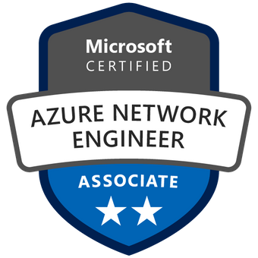
Tim Warner
Based in Nashville, TN, US
MCT, MVP
Twitter: @TechTrainerTim
Badge: TechTrainerTim.com

Slide 3
Day 1 of 2 Agenda
Introduction
Azure infrastructure design (25-30%)
Business continuity design (10-15%)
Monitoring design (10-15%)

Slide 4
Day 2 of 2 Agenda
Content catch-up
Identity and security design (25-30%)
Data storage design (15-20%)
Exam AZ-304 strategy

Slide 5
Course Materials
timw.info/az305

Slide 6
Expectations
We'll learn by doing – at least 80 percent demo
Visual, case study approach
This is an expert certification, so we move quickly and assume intermediate-level Azure skills
10-minute break at midpoint
I’m here to answer your questions – take advantage of this!
Use the Q&A panel

Slide 7
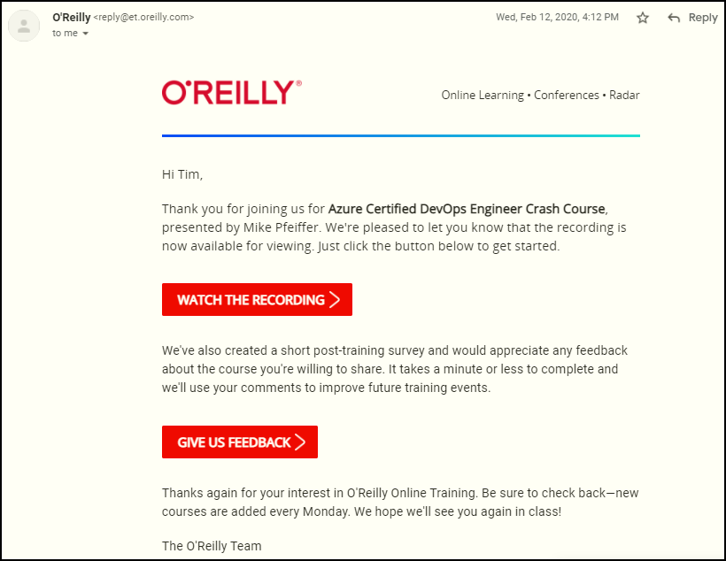
Session Recordings

Slide 8

Session Recordings

Slide 9

Session Recordings

Slide 10

Session Recordings

Slide 11


Mobile Browser: learning.oreilly.com

Slide 12



O'Reilly Mobile App

Slide 13
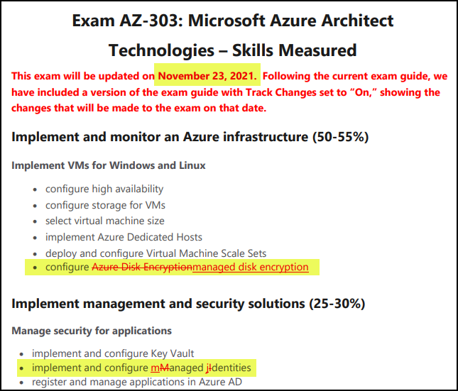
Azure Architect Cert Latest Changes

Slide 14
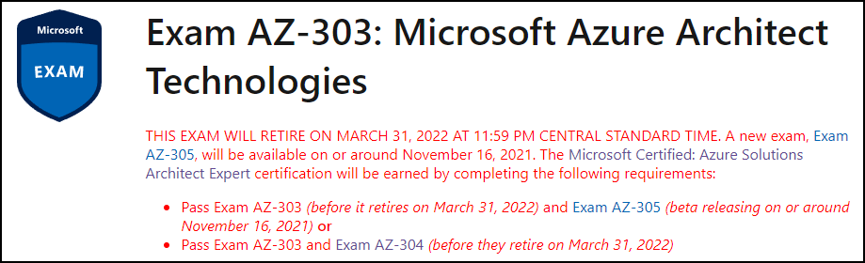
Azure Architect Cert Latest Changes
timw.info/qwb

Slide 15
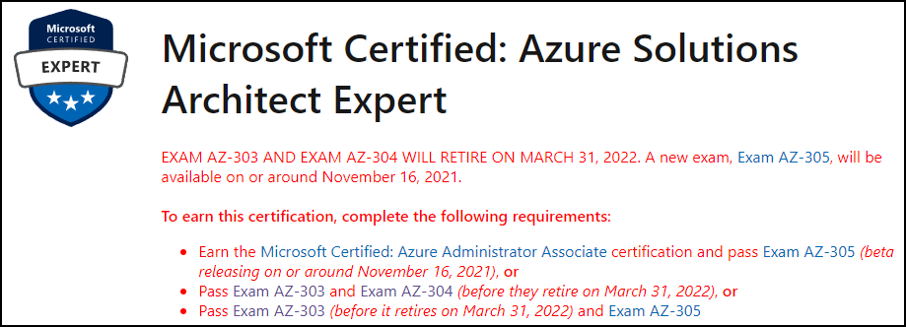
Azure Architect Cert Latest Changes
timw.info/qwb

Slide 16
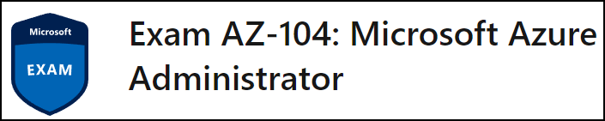
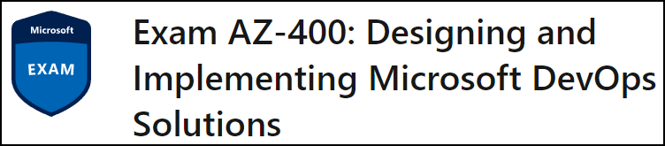
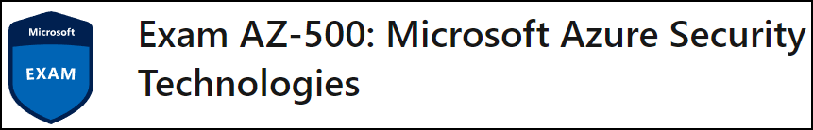
Related Certification Exams

Slide 17

Tim's Certification Study Model

Slide 18
Thank you!
Course materials: timw.info/az305
Twitter: @TechTrainerTim
Work: timw.info/ps
Web: TechTrainerTim.com

Slide 19
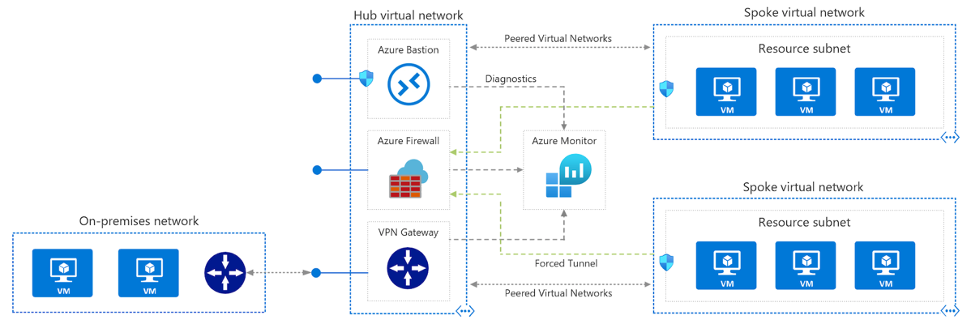
Azure VNet Hub-Spoke

Slide 20
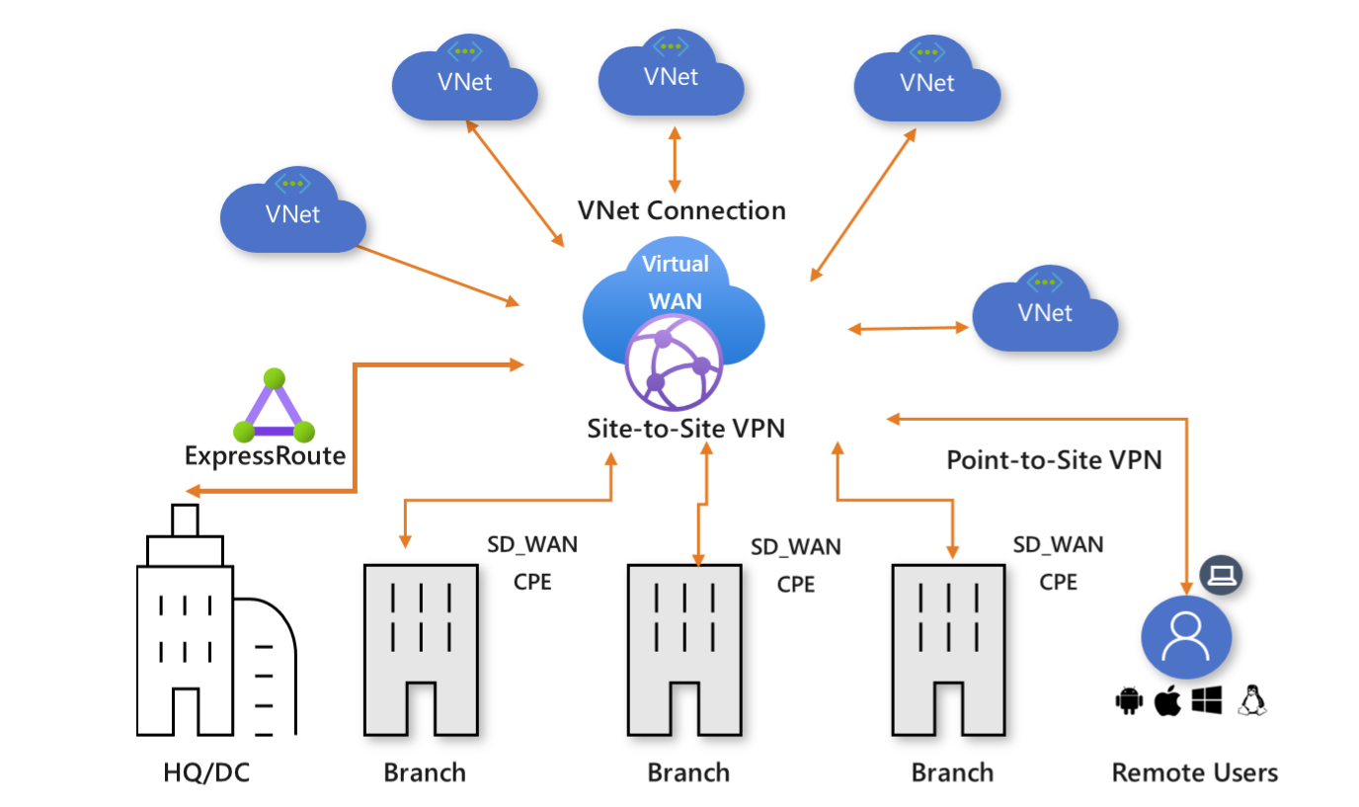
Azure Virtual WAN

Slide 21
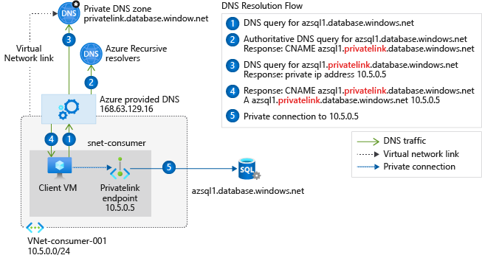
Private Link DNS Configuration

Slide 22

Azure Backup

Slide 23
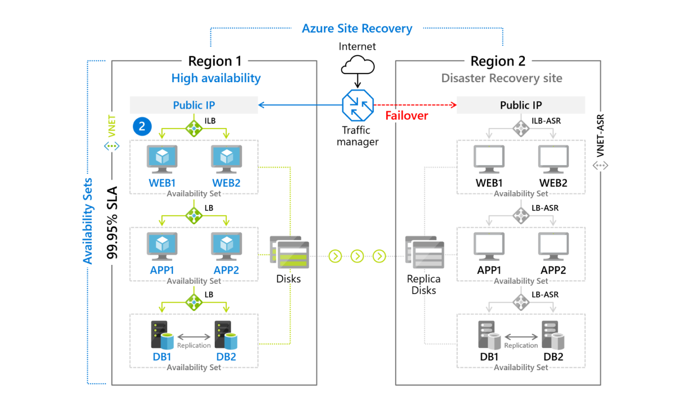
Azure Site Recovery

Slide 24

VM Scale Sets

Slide 25
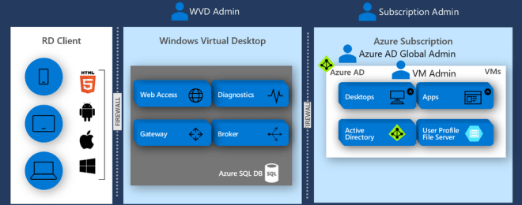
Windows Virtual Desktop (WVD)
timw.info/travis

Slide 26

Availability Set

Slide 27

Availability Zone

Slide 28

VM Networking

Slide 29

Load Balancing

Slide 30

VNet Peering

Slide 31

Hybrid Networking

Slide 32

Network Virtual Appliance

Slide 33

Azure Load Balancer

Slide 34

Application Gateway

Slide 35

Traffic Manager

Slide 36

Front Door Service

Slide 37


Docker Container Lifecycle
https://timw.info/3635f

Slide 38
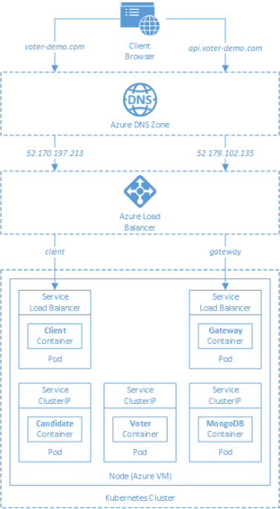
AKS

Slide 39
Azure Backup

Slide 40

Azure Site Recovery

Slide 41
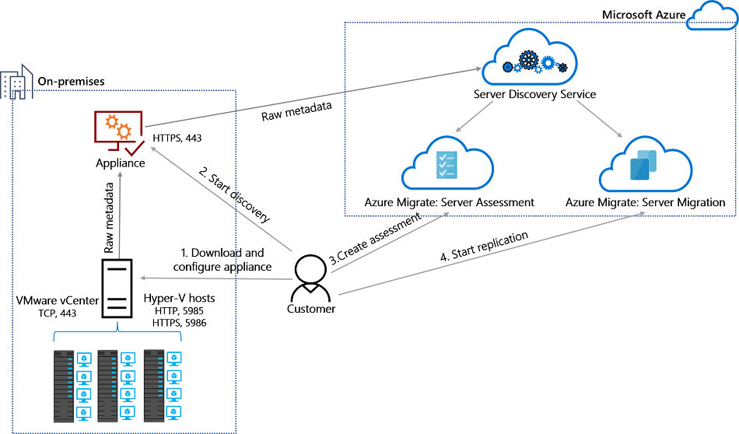
Azure Migrate

Slide 42
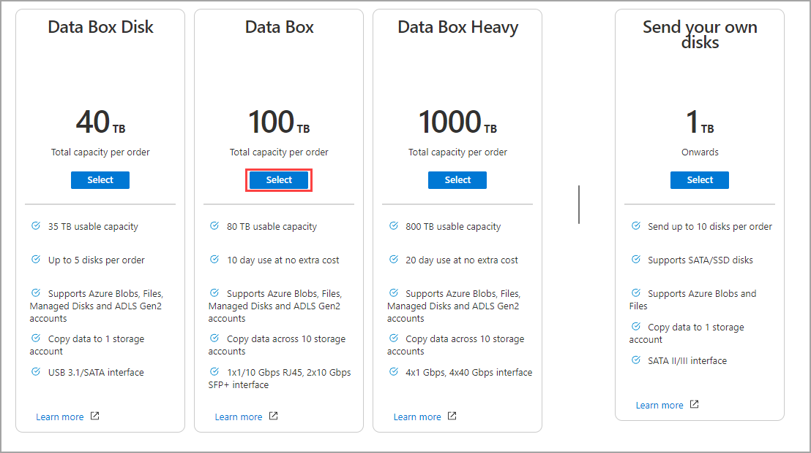
Azure Data Box

Slide 43

Azure Monitor

Slide 44

Log Analytics

Slide 45

Sentinel

Slide 46

Tenant vs. Subscription

Slide 47

Hybrid Identity

Slide 48

Azure AD B2C

Slide 49
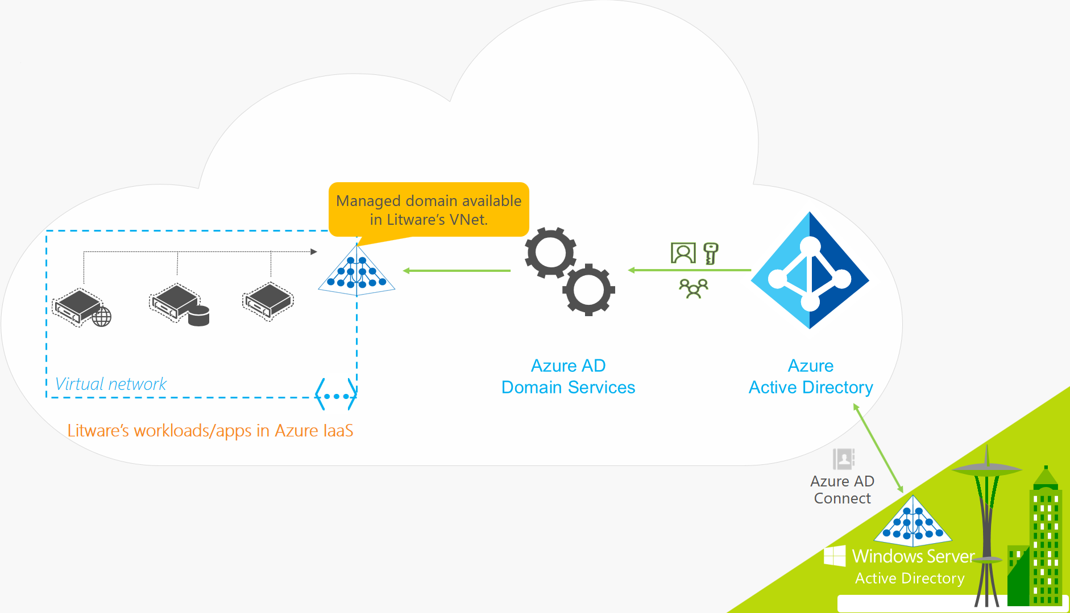
Azure AD Domain Services

Slide 50

Pass-through Authentication

Slide 51

Seamless Single Sign-on

Slide 52

Azure Management Scopes
/ Tenant Root

Slide 53

Data Pipelines

Slide 54
Storage Account Replication
1
3
3
2
LRS
ZRS

Slide 55
Storage Account Replication
3
3
GRS/RA-GRS

Slide 56
Storage Account Replication
1
3
1
3
2
2
GZRS – RA/GZRS

Slide 57

Always Encrypted

Slide 58
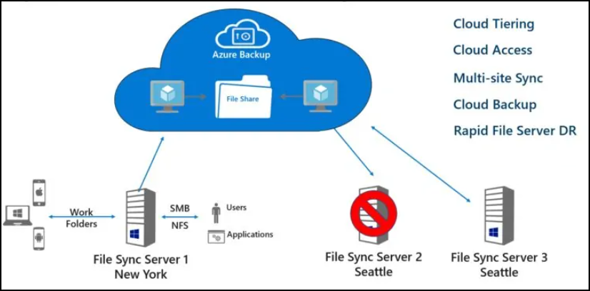
Azure File Sync

Slide 59
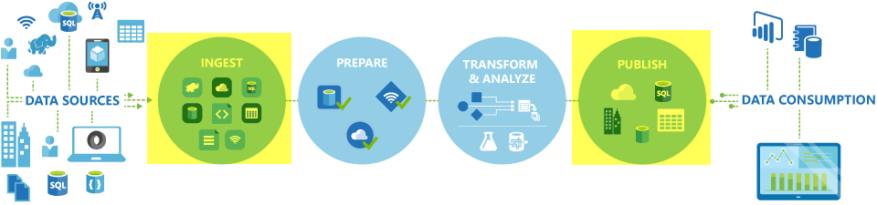
Azure Data Factory

Slide 60

Event Architecture

Slide 61

Event Architecture

Slide 62
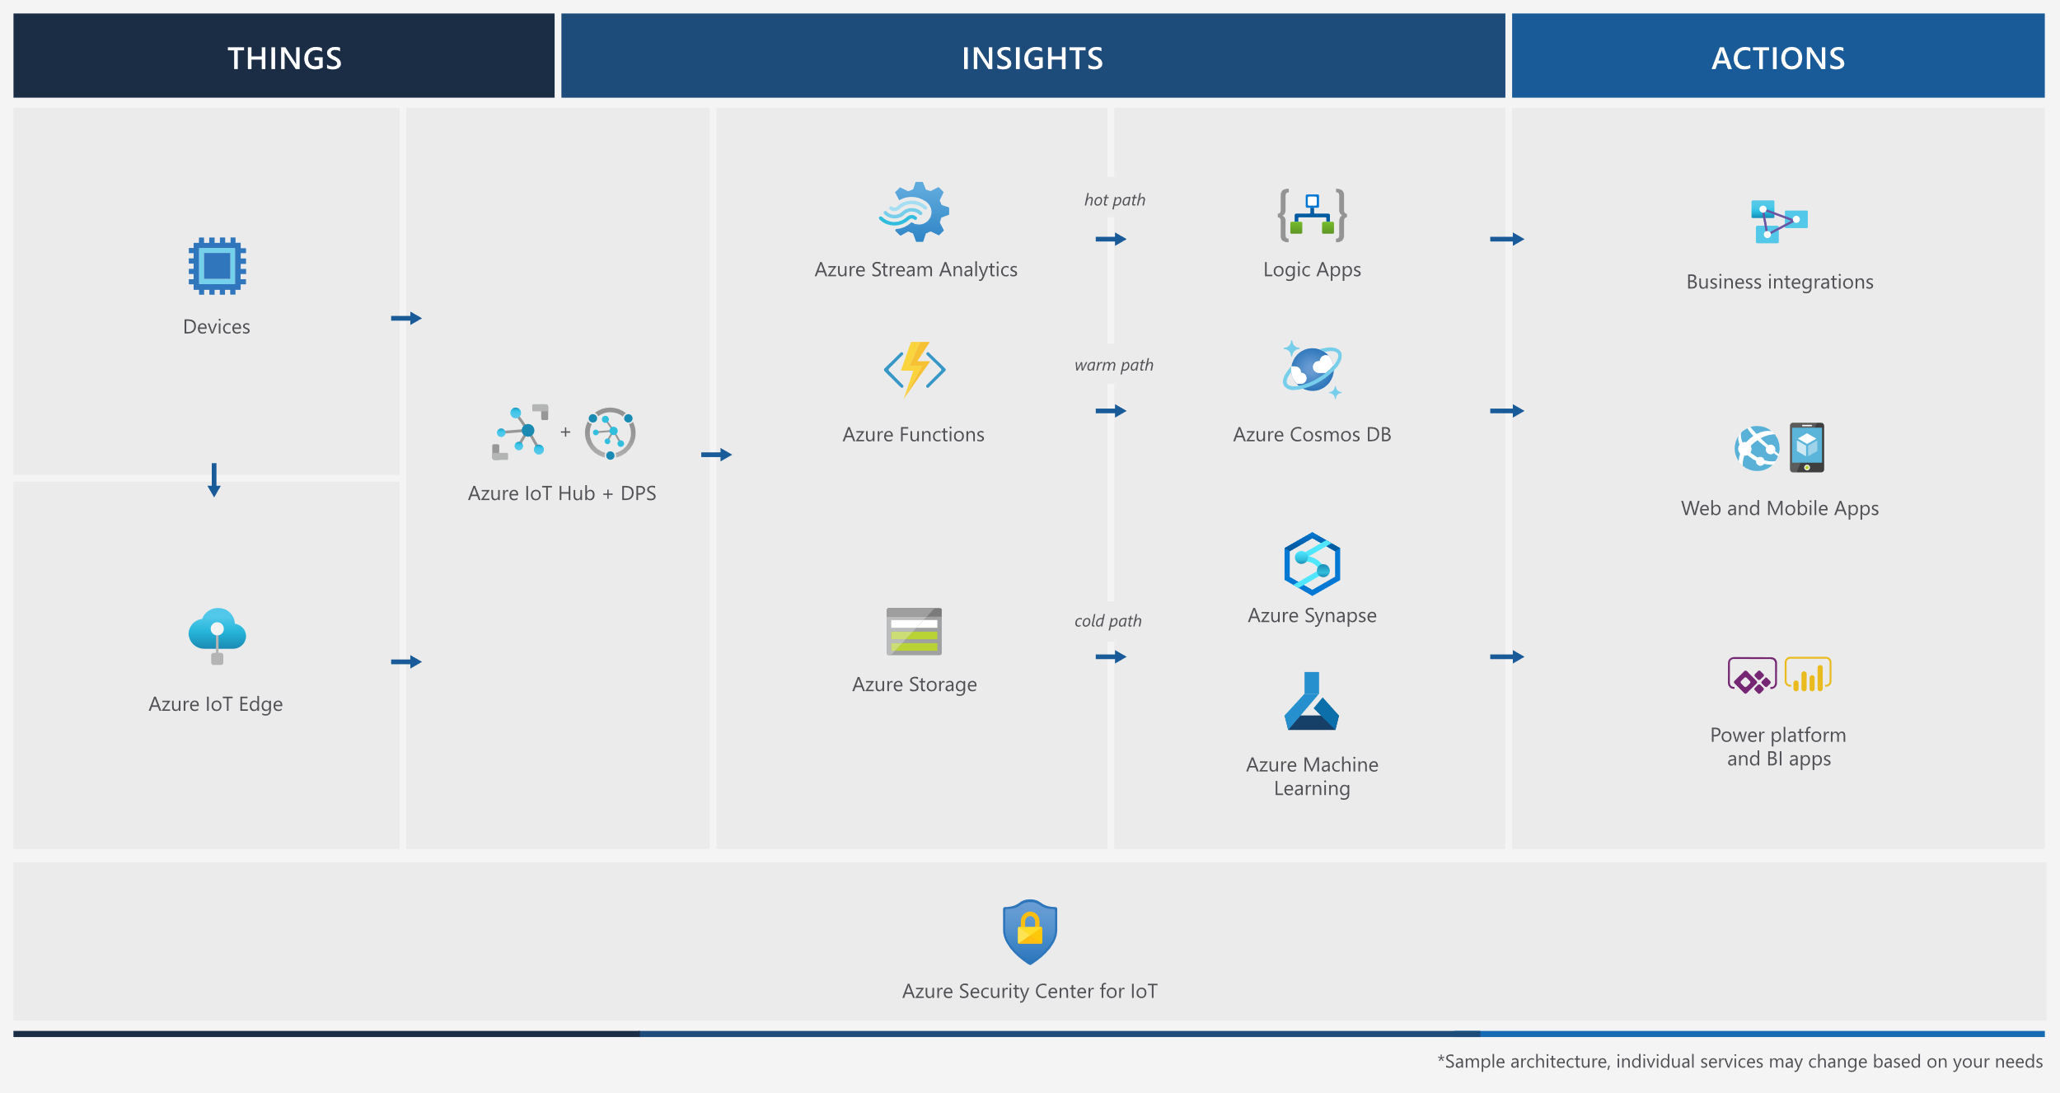
Event Architecture

Slide 63
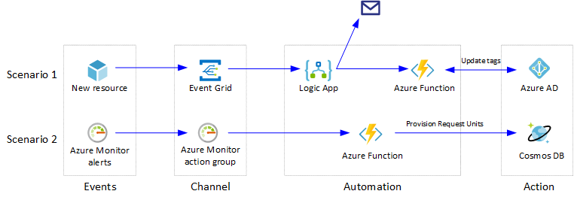
Event Architecture

Slide 64
Exam AZ-304 Item Types

Slide 65

Multiple Choice

Slide 66
Repeated Scenario
You need to move an Azure VM to another hardware host.
Solution: You redeploy the VM.
Does this solution meet the goal?
Yes
No

Slide 67

Select and Place

Slide 68

Build List and Reorder

Slide 69

Active Screen/Fill in the Blank

Slide 70

Case Study

Slide 71






Performance-Based Lab

Slide 72
Microsoft Online Testing

Slide 73
Microsoft Online Testing Process
timw.info/online

Slide 74

Microsoft Online Testing Process

Slide 75

Microsoft Online Testing Process

Slide 76

Microsoft Online Testing Process

Slide 77

Microsoft Online Testing Process

Slide 78

Microsoft Online Testing Process

Slide 79

Microsoft Online Testing Process

Slide 80

Microsoft Online Testing Process

Slide 81
AZ-304 Exam Strategy
Focus your skills accordingly:
60 percent Azure portal
20 percent Azure PowerShell
10 percent Azure CLI
10 percent KQL
Expect performance-based labs, but be thankful if you don't see 'em

